Slide 1

NSG Pilkington – University of Liverpool Machine Learning Project: 18/08/2020
Dr. Peter Green
Diego Echeverria
Risk Institute,
School of Engineering
11/08/2020

Slide 2
Conclusions from the 18/08/2020 meeting
Regularised Least Squares parameter convergence: Some input parameters diverged as we increased the number of observations.
Giving a closer look to the inputs, we could identify that some of them were not relevant for the furnace process, for instance:
Pollution plant
UK6 data
This suggested a closer input analysis were the team will identify the furnace labels that we should look when the “pre-processing” task is carried on. From the “UK5 Data Set Definitions and Data Sets” excel file, “Tag definitions” tab and “FactoryAreaName” column, select, for instance:
Furnace
“Some” Bath
“Some” Services

Slide 3
Conclusions from the 18/08/2020 meeting
In the “pre-processing” task, specifically in the “input correlation analysis”, where we chose only one of the highly correlated inputs. We have eliminated some inputs that are more relevant for the control operators to take actions or decisions. Or are better indicators of that furnace process.
Discuss whether to include PV, OP, SP
Matt talked about some furnace process time lags, which ranges from 4 hours to 24 hours (approximately).
This initial knowledge of the time lags, allows us to automatically identify the time lags associated with its inputs in the following way.

Slide 4
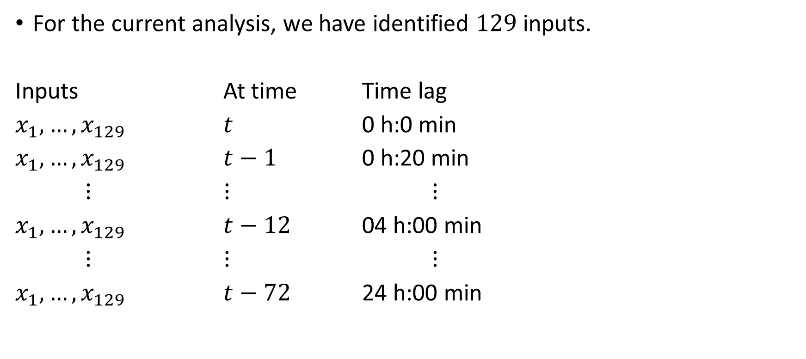
Input dataset constructed with previous inputs (time lags)
For the current analysis, we have identified $129$ inputs.
Inputs At time Time lag
$x_{1}, …, x_{129}$ $t$ 0 h:0 min
$x_{1}, …, x_{129}$ $t−1$ 0 h:20 min
$⋮$ $⋮$ $⋮$
$x_{1}, …, x_{129}$ $t−12$ 04 h:00 min
$⋮$ $⋮$ $⋮$
$x_{1}, …, x_{129}$ $t−72$ 24 h:00 min

Slide 5

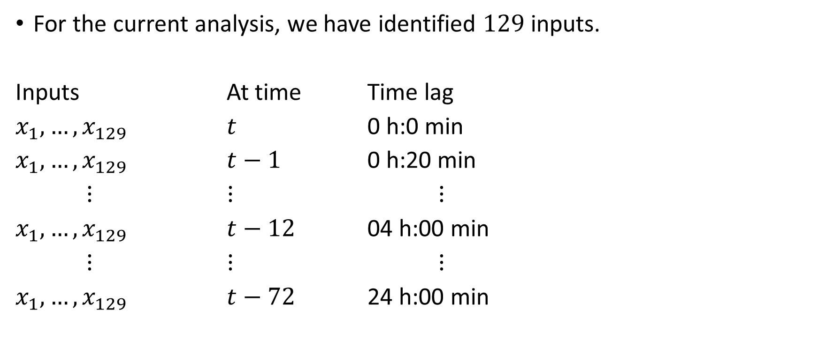
Input dataset constructed with previous inputs (time lags)
For the current analysis, we have identified $129$ inputs.
Inputs At time Time lag
$x_{1}, …, x_{129}$ $t$ 0 h:0 min
$x_{1}, …, x_{129}$ $t−1$ 0 h:20 min
$⋮$ $⋮$ $⋮$
$x_{1}, …, x_{129}$ $t−12$ 04 h:00 min
$⋮$ $⋮$ $⋮$
$x_{1}, …, x_{129}$ $t−72$ 24 h:00 min
Therefore, the number of inputs is
$$N of inputs=N of sensors x 72$$ $$N of inpust=129 x 72=9288$$

Slide 6
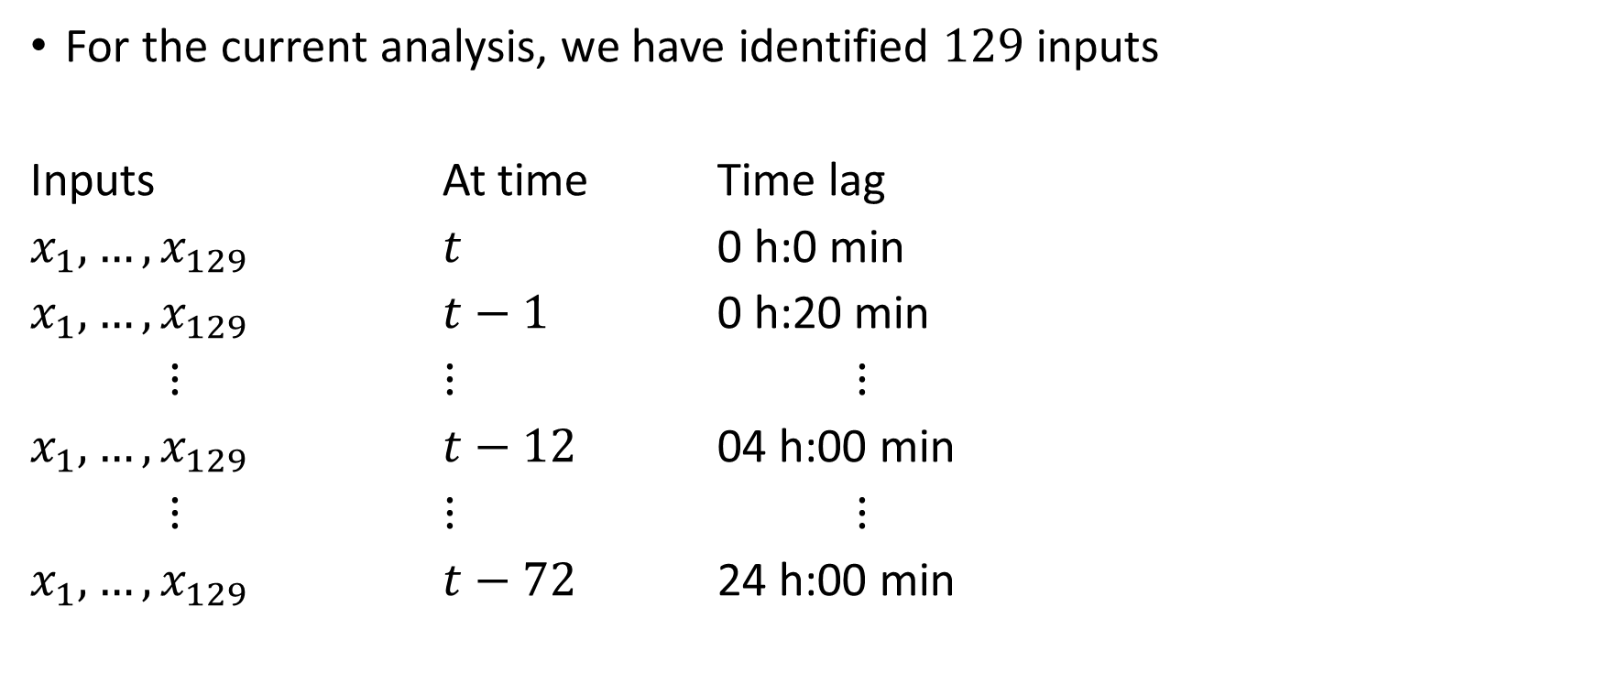
Input dataset constructed with previous inputs (time lags)
For the current analysis, we have identified $129$ inputs
Inputs At time Time lag
$x_{1}, …, x_{129}$ $t$ 0 h:0 min
$x_{1}, …, x_{129}$ $t−1$ 0 h:20 min
$⋮$ $⋮$ $⋮$
$x_{1}, …, x_{129}$ $t−12$ 04 h:00 min
$⋮$ $⋮$ $⋮$
$x_{1}, …, x_{129}$ $t−72$ 24 h:00 min
N of inputs > N of observations 9288 > 2410

Slide 7
Input dataset constructed with previous inputs (time lags)
The number of inputs is greater than the number of observations, which will give us a perfect fit.
We will not be able to identify the optimum parameters.
For 129 inputs, we would require more data to perform the time lag analysis.
As an alternative, a “Feature identification analysis” can be carried out to see if the correlation between the inputs (at different time lags) and the output increases. In theory, the correlation coefficient of some inputs should increase when changing the time lags.

Slide 8
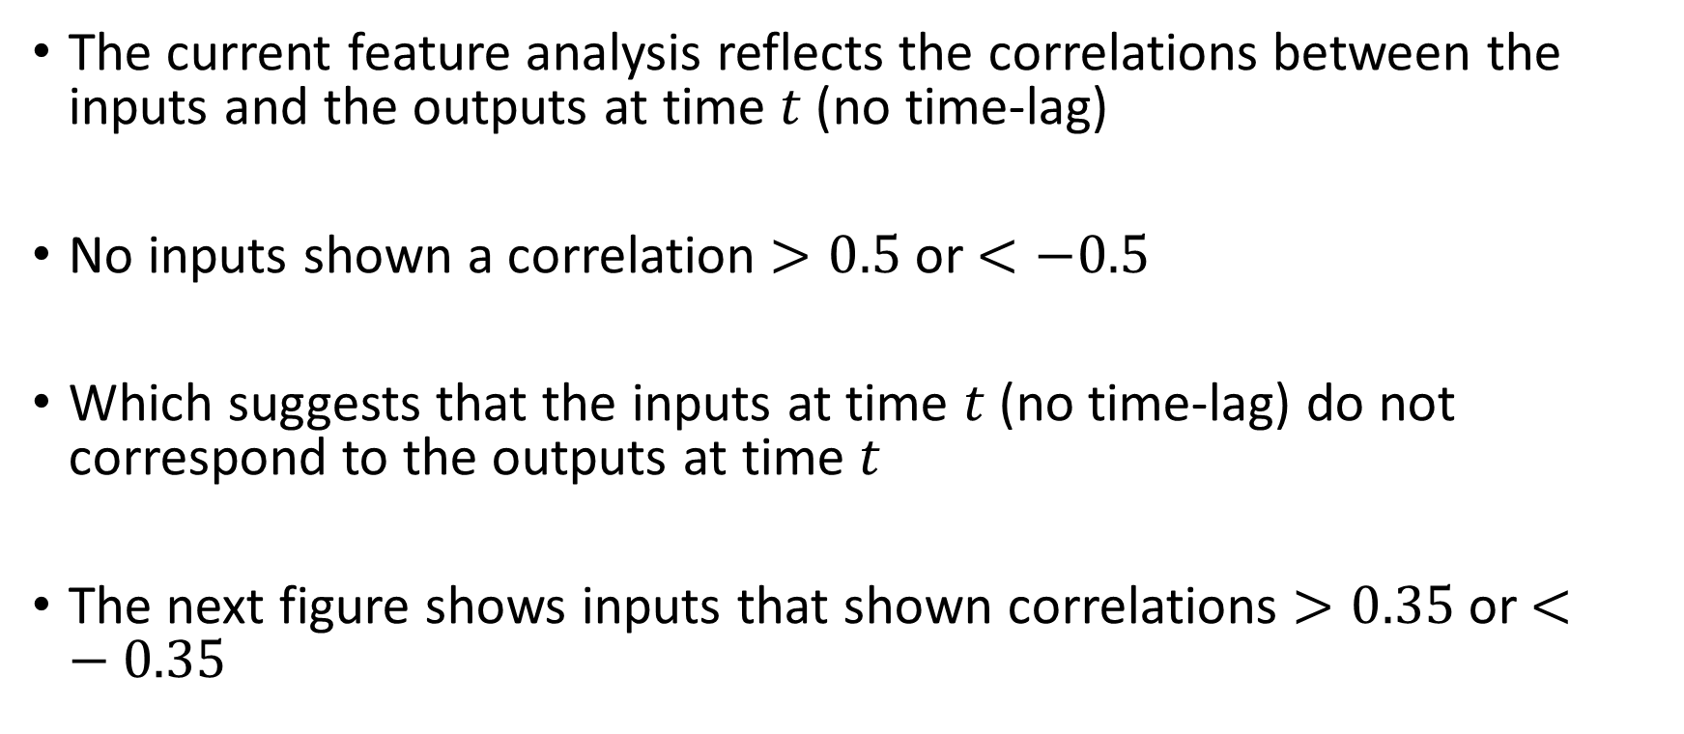
Feature analysis with no time-lag
The current feature analysis reflects the correlations between the inputs and the outputs at time $t$ (no time-lag)
No inputs shown a correlation $>0.5$ or $<−0.5$
Which suggests that the inputs at time $t$ (no time-lag) do not correspond to the outputs at time $t$
The next figure shows inputs that shown correlations $>0.35$ or $<−0.35$

Slide 9
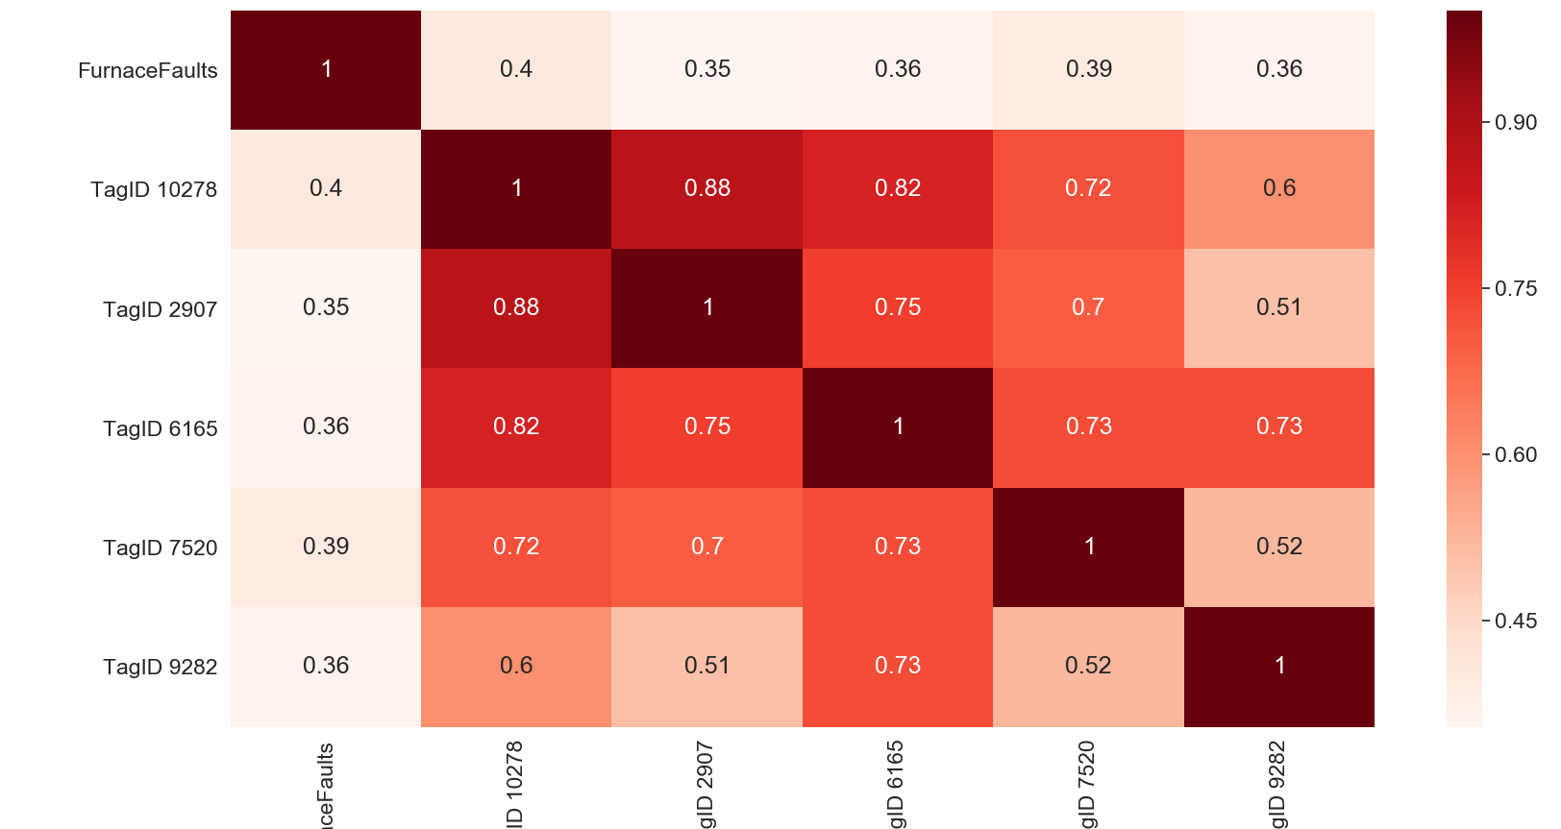
Feature analysis with no time-lag

Slide 10
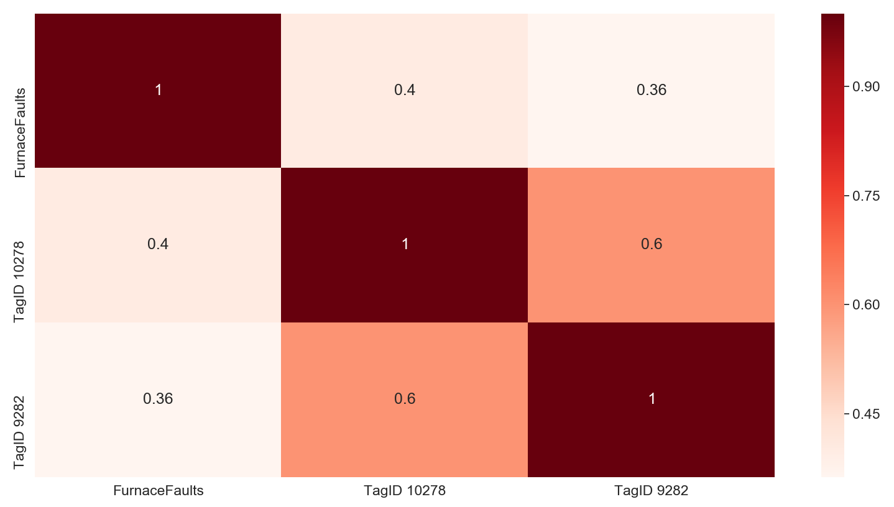
Feature analysis with no time-lag
After eliminating highly correlated inputs:

Slide 11
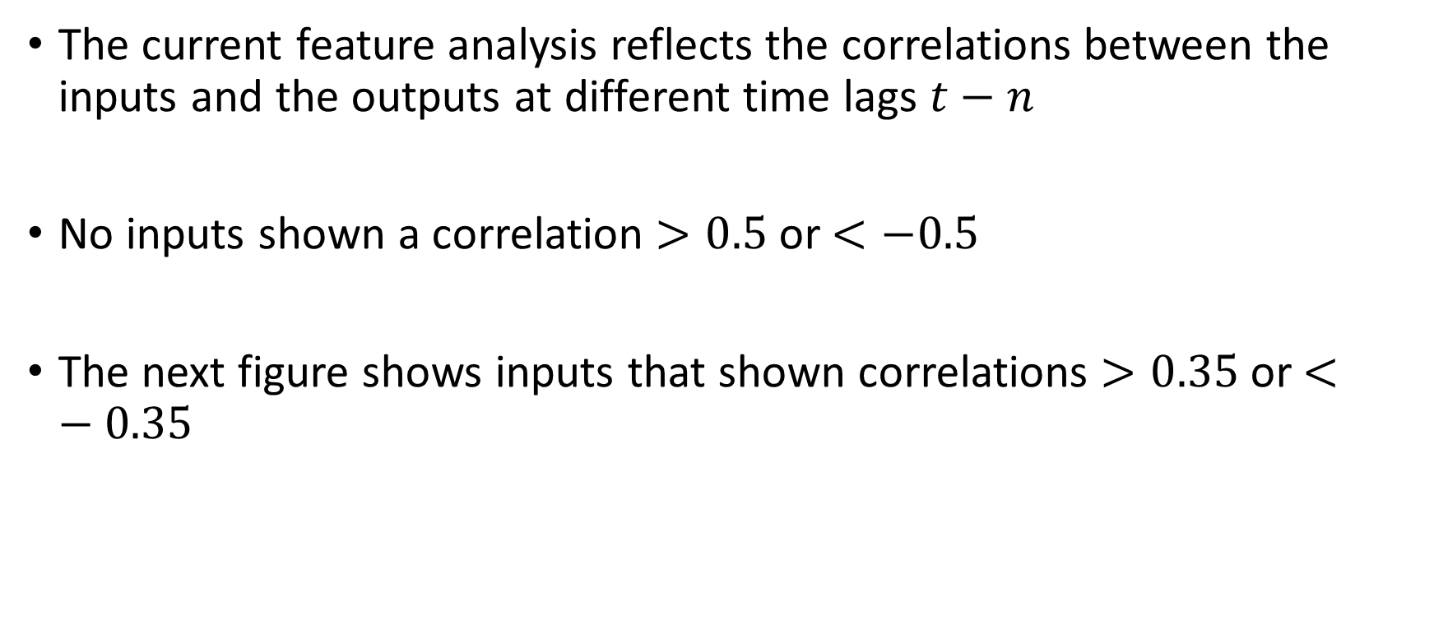
Feature analysis with different time lags
The current feature analysis reflects the correlations between the inputs and the outputs at different time lags $t−n$
No inputs shown a correlation $>0.5$ or $<−0.5$
The next figure shows inputs that shown correlations $>0.35$ or $<−0.35$

Slide 12
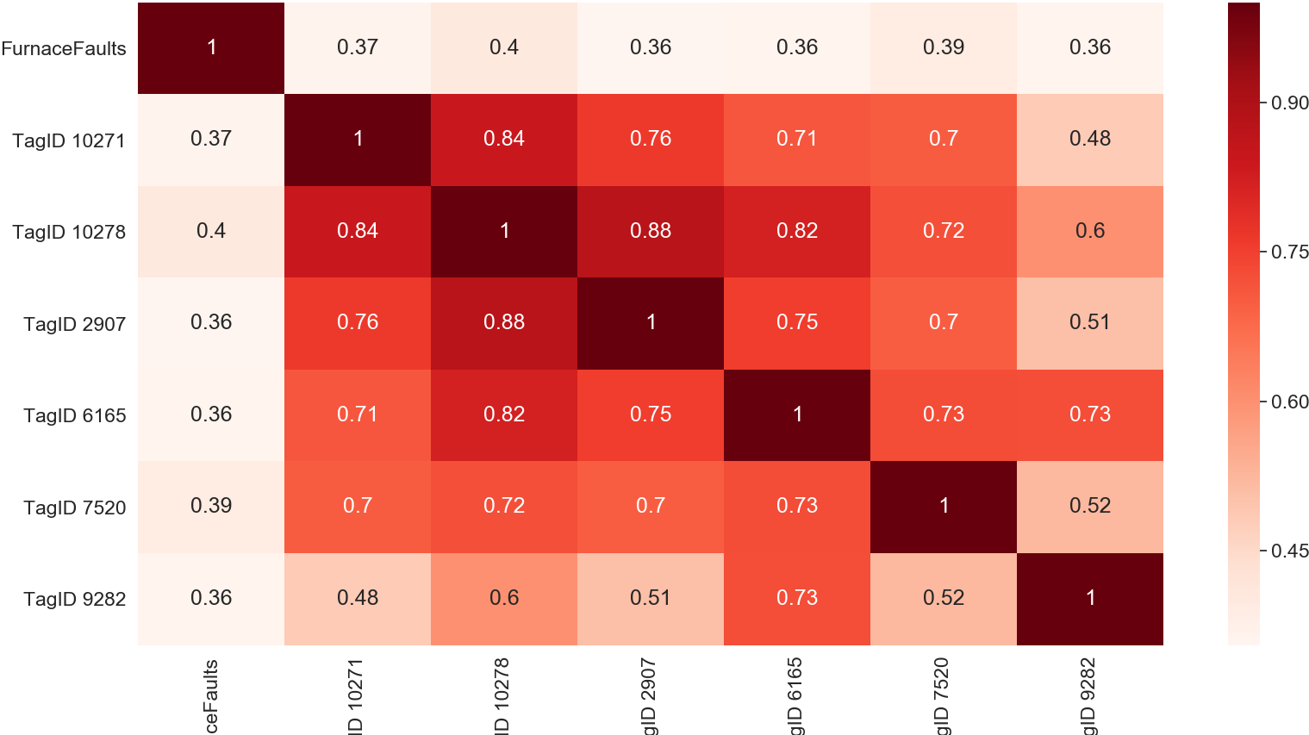
Feature analysis with time lag = 4 hours

Slide 13

Feature analysis with time lag = 15 hours

Slide 14

Feature analysis with time lag = 24 hours

Slide 15
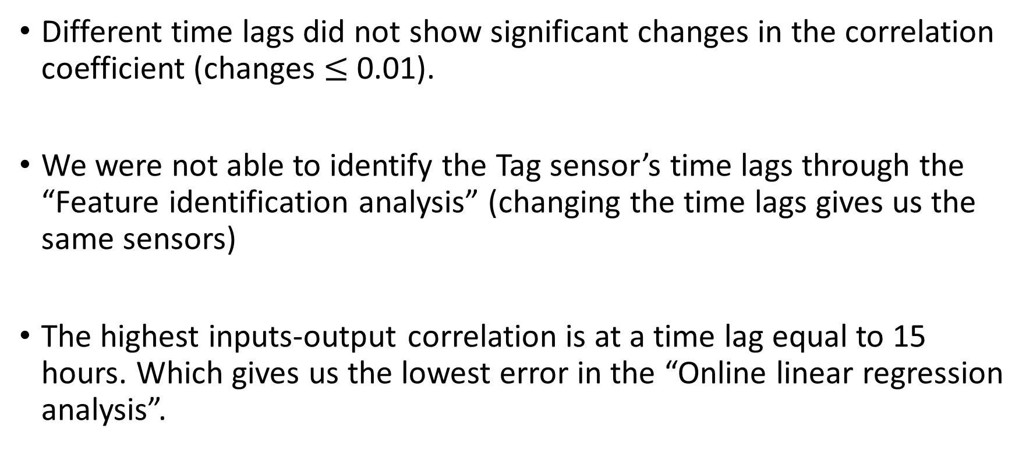
Feature analysis with different time lags
Different time lags did not show significant changes in the correlation coefficient (changes $≤$ 0.01).
We were not able to identify the Tag sensor’s time lags through the “Feature identification analysis” (changing the time lags gives us the same sensors)
The highest inputs-output correlation is at a time lag equal to 15 hours. Which gives us the lowest error in the “Online linear regression analysis”.

Slide 16
Thank you for your attention. ANY QUESTIONS?

